Slide 2

Netflix Data Analaysis Using SQL
SHAIK MOHAMMED IKRAM

Slide 3




Table Of Contents
Introduction
Project Setup
Analysis
Conclusion
LEARN MORE

Slide 4


Breif Introduction
Introduction
This project involves analyzing Netflix's comprehensive dataset, which includes details about movies and TV shows such as title, director, cast, country, date added, release year, rating, and duration. The goal is to uncover meaningful insights, trends, and patterns using structured queries and advanced SQL functions.
Key Objectives:
Understand the distribution and characteristics of Netflix's content library.
Perform data cleaning to ensure accuracy and consistency.
Derive valuable insights such as top-rated titles, content trends by region, and monthly additions.
Implement advanced SQL techniques, including stored procedures and cumulative calculations.
The project demonstrates a practical application of database management and analytical skills, focusing on providing actionable insights from large-scale entertainment data.

Slide 5
Project Setup

Slide 6
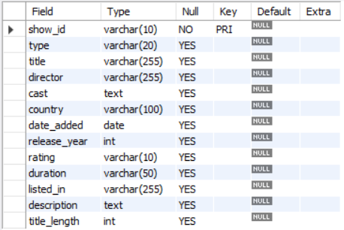
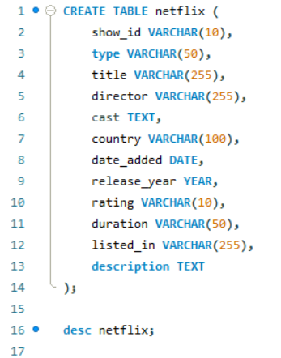
Setup File

Slide 7
Data Analysis
TOTAL WATCHTIME
450 hrs
TOP GENRES
Drama, Action, Sci-Fi, Fantasy

Slide 8


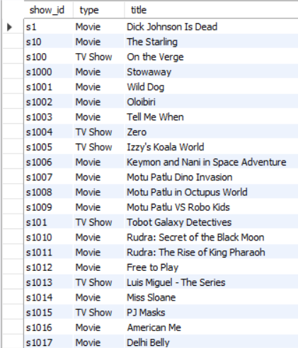

Our Output
Our Mission
Q1. Write a query to list all titles with their show_id, title, and type.
Our Vision
SELECT show_id,type,title
FROM netflix;

Slide 9
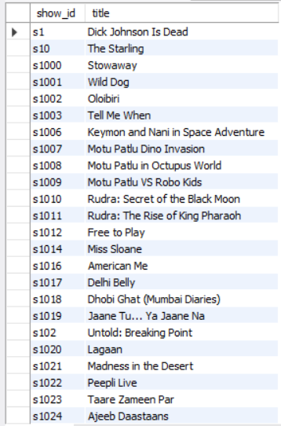
Our Output
Our Mission
Q2. Write a query to display all columns for titles that are Movies.
Our Vision
SELECT show_id,title
FROM netflix
WHERE type='Movie';

Slide 10

Our Output
Our Mission
Q3. Write a query to list TV shows that were released in the year 2021.
Our Vision
SELECT title
FROM netflix
WHERE type='TV Show'
AND release_year=2021;

Slide 11

Our Output
Our Mission
Q4.Write a query to find all titles where the description contains the word family.
Our Vision
SELECT title
FROM netflix
WHERE description LIKE "%family%";

Slide 12
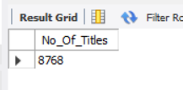
Our Output
Our Mission
Q5. Write a query to count the total number of titles in the dataset.
Our Vision
SELECT count(title) as No_Of_Titles
FROM netflix;

Slide 13
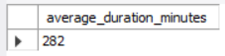
Our Output
Our Mission
Q6. Write a query to find the average duration of all movies (in minutes, wherever the season is mentioned, consider 400 minutes per season).
Our Vision
SELECT
ROUND(AVG(
CASE
WHEN duration LIKE '%Season%' THEN CAST(SUBSTRING_INDEX(duration, ' ', 2) AS UNSIGNED) * 400
ELSE CAST(SUBSTRING_INDEX(duration, ' ', 1) AS UNSIGNED)
END
),0) AS average_duration_minutes
FROM netflix;

Slide 14
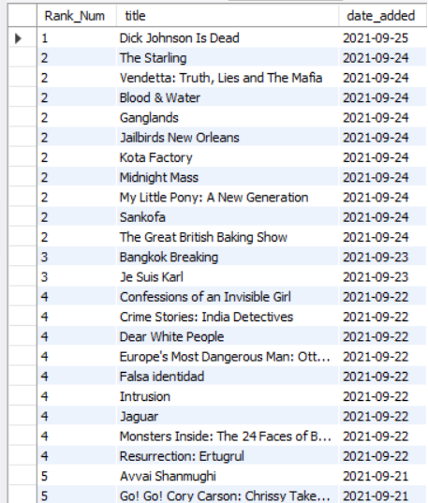
Our Output
Our Mission
Q7. Write a query to list the top 5 latest titles based on the date_added, sorted in descending order.
Our Vision
SELECT * FROM
(SELECT DENSE_RANK() OVER(ORDER BY date_added DESC) AS Rank_Num,
title,date_added
FROM netflix) AS Derived
WHERE Rank_Num<=5;

Slide 15
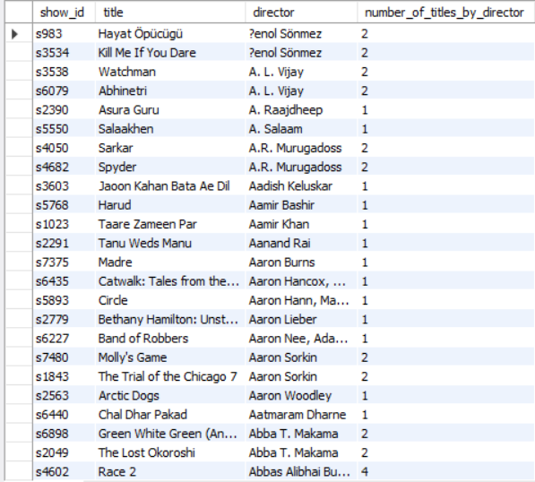
Our Output
Our Mission
Q8. Write a query to list all titles along with the number of other titles by the same director. Include columns for show_id, title, director, and number_of_titles_by_director.
Our Vision
CREATE TEMPORARY TABLE Dir_count AS
(SELECT director,count(director) as Count_of
FROM netflix
WHERE director <> 'Unknown'
GROUP BY director);
select n.show_id,n.title,n.director,d.Count_of as number_of_titles_by_director
FROM netflix n
INNER JOIN Dir_Count d
ON n.director=d.director
ORDER BY n.director;

Slide 16
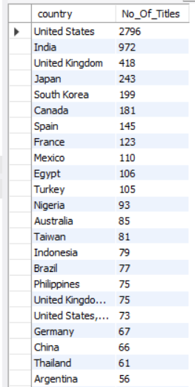
Our Output
Our Mission
Q9. Write a query to find the total number of titles for each country. Display country and the count of titles.
Our Vision
SELECT country,COUNT(title) as No_Of_Titles
FROM netflix
WHERE country <> 'Unknown'
GROUP BY country
ORDER BY COUNT(title) DESC;

Slide 17
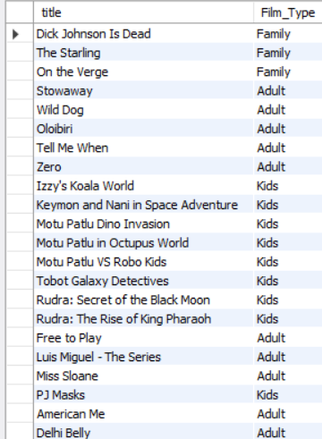
Our Output
Our Mission
Q10. Write a query using a CASE statement to categorize titles into three categories based on their rating: Family for ratings G, PG, PG-13, Kids for TV-Y, TV-Y7, TV-G, and Adult for all other ratings.
Our Vision
SELECT title,
CASE
WHEN rating IN ('G', 'PG', 'PG-13') THEN 'Family'
WHEN rating IN ('TV-Y', 'TV-Y7', 'TV-G') THEN 'Kids'
ELSE 'Adult'
END AS Film_Type
FROM netflix;

Slide 18
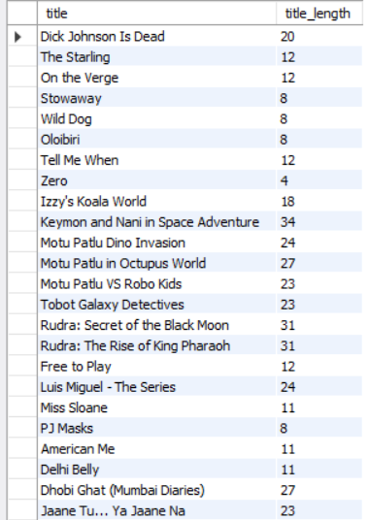
Our Output
Our Mission
Q11. Write a query to add a new column title_length to the titles table that calculates the length of each title.
Our Vision
ALTER TABLE netflix
ADD COLUMN title_length INT;
UPDATE netflix
SET title_length =
CASE
WHEN title='Unknown' THEN NULL
ELSE LENGTH(title)
END;
SELECT title,title_length
FROM netflix;

Slide 19

Our Output
Our Mission
Q12. Write a query using an advanced function to find the title with the longest duration in minutes.
Our Vision
SELECT title,duration,duration_in_min
FROM
(SELECT title,duration,
CASE
WHEN duration LIKE "%Season%" THEN CAST(SUBSTRING_INDEX(duration,' ',1) AS UNSIGNED)*400
ELSE CAST(SUBSTRING_INDEX(duration,' ',1) AS UNSIGNED)
END AS duration_in_min
FROM netflix) AS derived
ORDER BY duration_in_min DESC
LIMIT 1;

Slide 20

Our Output
Our Mission
Q13. Create a view named RecentTitles that includes titles added in the last 30 days.
Our Vision
CREATE VIEW RecentTitle AS
SELECT title
FROM netflix
WHERE date_added >=
(SELECT DATE_SUB(MAX(date_added), INTERVAL 30 DAY) FROM netflix);
Select * from RecentTitle;

Slide 21
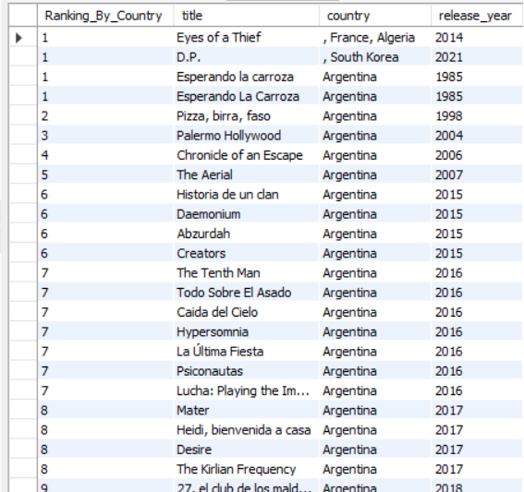
Our Output
Our Mission
Q14. Write a query using a window function to rank titles based on their release_year within each country.
Our Vision
SELECT DENSE_RANK() OVER(PARTITION BY COUNTRY ORDER BY release_year) AS Ranking_By_Country,
title,country,release_year
FROM netflix
WHERE country <> 'Unknown';

Slide 22
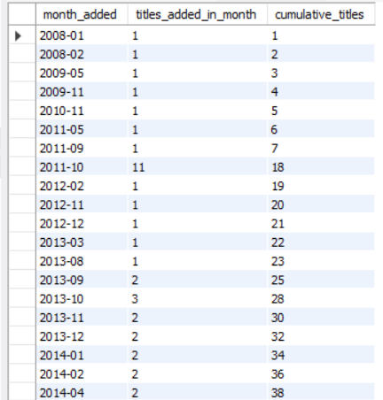
Our Output
Our Mission
Q15. Write a query to calculate the cumulative count of titles added each month sorted by date_added.
Our Vision
SELECT
DATE_FORMAT(date_added, '%Y-%m') AS month_added,
COUNT(*) AS titles_added_in_month,
SUM(COUNT(*)) OVER (ORDER BY DATE_FORMAT(date_added, '%Y-%m')
ROWS BETWEEN UNBOUNDED PRECEDING AND CURRENT ROW) AS cumulative_titles
FROM netflix
WHERE date_added IS NOT NULL
GROUP BY DATE_FORMAT(date_added, '%Y-%m');

Slide 23
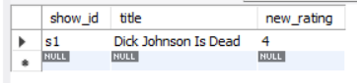
Our Output
Our Vision
ALTER TABLE netflix
ADD COLUMN new_rating INT DEFAULT NULL;
DELIMITER $$
CREATE PROCEDURE AddNewRating(
IN p_show_id VARCHAR(20), IN p_new_rating INT
)
BEGIN
IF p_new_rating BETWEEN 1 AND 5 THEN
UPDATE netflix
SET new_rating = p_new_rating WHERE show_id = p_show_id;
IF ROW_COUNT() = 0 THEN
SIGNAL SQLSTATE '45000'
SET MESSAGE_TEXT = 'No title found with the given show_id';
END IF;
ELSE
SIGNAL SQLSTATE '45000'
SET MESSAGE_TEXT = 'Rating must be between 1 and 5';
END IF;
END $$
DELIMITER ;
CALL AddNewRating('s1', 4);
Our Mission
Q16. Write a stored procedure to update the rating of a title given its show_id and new rating.

Slide 24

Our Output
Our Mission
Q17. Write a query to find the country with the highest average rating for titles. Use subqueries and aggregate functions to achieve this.
Our Vision
UPDATE netflix
SET new_rating = FLOOR(1 + (RAND() * 5));
SELECT
country, avg_rating
FROM (
SELECT country, AVG(new_rating) AS avg_rating
FROM netflix
WHERE country <> 'Unknown'
GROUP BY country
) AS country_avg
ORDER BY avg_rating DESC
LIMIT 1;

Slide 25
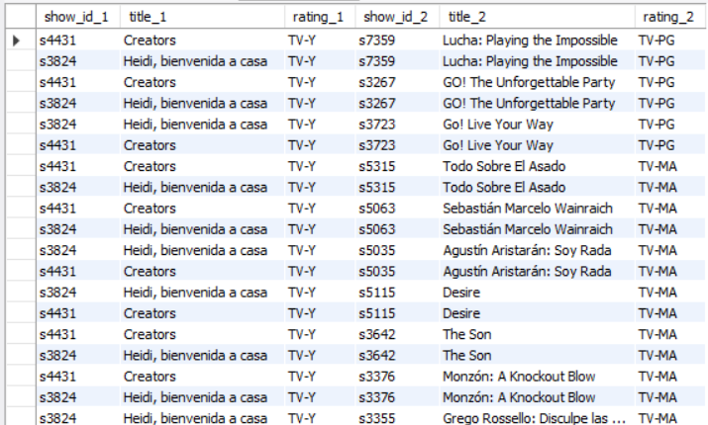
Our Output
Our Mission
Q18. Write a query to find pairs of titles from the same country where one title has a higher rating than the other. Display columns for show_id_1, title_1, rating_1, show_id_2, title_2, and rating_2.
Our Vision
SELECT
t1.show_id AS show_id_1,
t1.title AS title_1,
t1.rating AS rating_1,
t2.show_id AS show_id_2,
t2.title AS title_2,
t2.rating AS rating_2
FROM netflix t1
JOIN netflix t2
ON t1.country = t2.country
AND t1.show_id != t2.show_id
AND t1.rating > t2.rating
WHERE t1.rating <> 'Unknown' AND t2.rating <> 'Unknown'
ORDER BY t1.country, t1.rating DESC, t2.rating DESC;

Slide 26
The Conclusion
Conclusion
The Netflix Titles Analysis project highlights the power of SQL in extracting meaningful insights from large datasets. By analyzing content trends, ratings, and regional distributions, this project demonstrates how data-driven decisions can enhance understanding of entertainment platforms. The insights gained can help in content strategy, audience targeting, and market expansion efforts.

Slide 27



Contact Us
LinkedIn
linkedin.com/in/ikram-shaik-
Mail
ikramshaik0720@gmail.com
Github
github.com/Ikram-Shaik
14

Slide 28
THANK YOU

